Slide 1
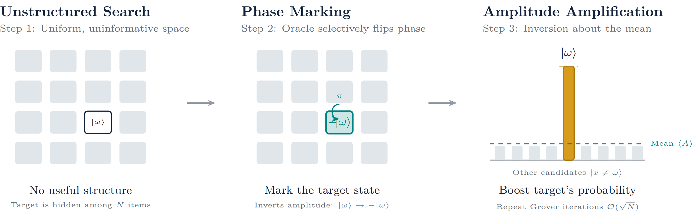
GROVER’S SEARCH ALGORITHM
Unstructured search → phase marking → amplitude amplification
Find a marked state with a quadratic reduction in oracle queries.

Slide 2
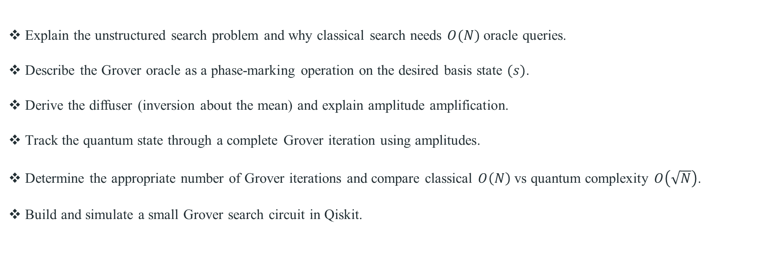
Week 10 Learning Objectives
Explain the unstructured search problem and why classical search needs $O(N)$ oracle queries.
Describe the Grover oracle as a phase-marking operation on the desired basis state $(s)$.
Derive the diffuser (inversion about the mean) and explain amplitude amplification.
Track the quantum state through a complete Grover iteration using amplitudes.
Determine the appropriate number of Grover iterations and compare classical $O\left(N\right)$ vs quantum complexity $O\left(\sqrt{N}\right)$.
Build and simulate a small Grover search circuit in Qiskit.

Slide 3
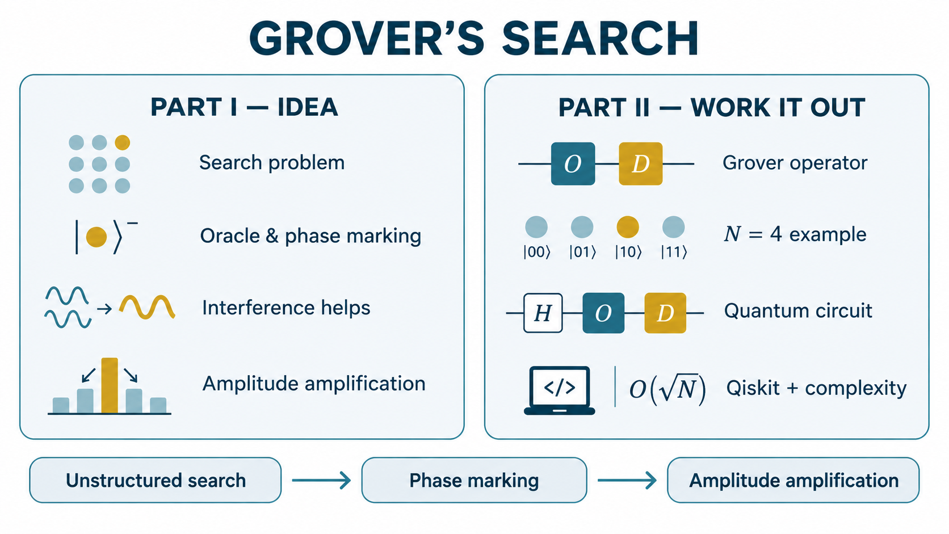

Slide 4
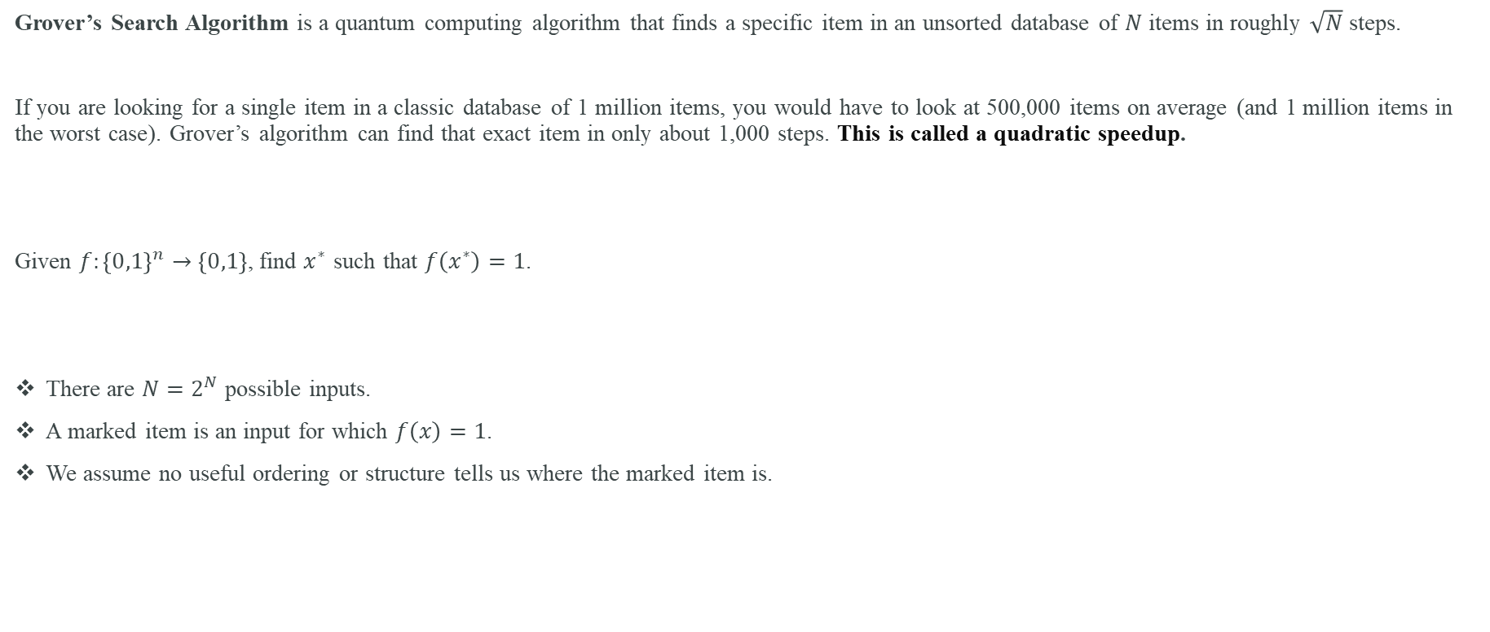
what problem is Grover solving?
Grover’s Search Algorithm is a quantum computing algorithm that finds a specific item in an unsorted database of $N$ items in roughly $\sqrt{N}$steps.
If you are looking for a single item in a classic database of 1 million items, you would have to look at 500,000 items on average (and 1 million items in the worst case). Grover’s algorithm can find that exact item in only about 1,000 steps. This is called a quadratic speedup.
Given $f:{\left\{0,1\right\}}^{n}→\left\{0,1\right\}$, find $x^{∗}$ such that $f\left(x^{∗}\right)=1$.
There are $N=2^{N}$ possible inputs.
A marked item is an input for which $f\left(x\right)=1$.
We assume no useful ordering or structure tells us where the marked item is.

Slide 5
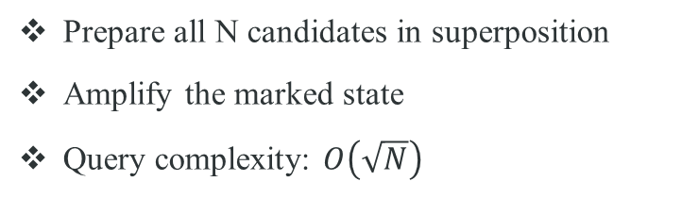
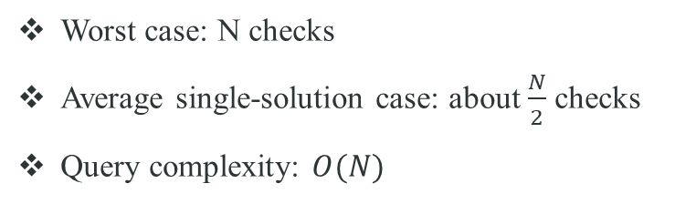
CLASSICAL SEARCH VS QUANTUM SEARCH
CLASSICAL
GROVER
Worst case: N checks
Average single-solution case: about $\frac{N}{2}$ checks
Query complexity: $O(N)$
Prepare all N candidates in superposition
Amplify the marked state
Query complexity: $O\left(\sqrt{N}\right)$

Slide 6
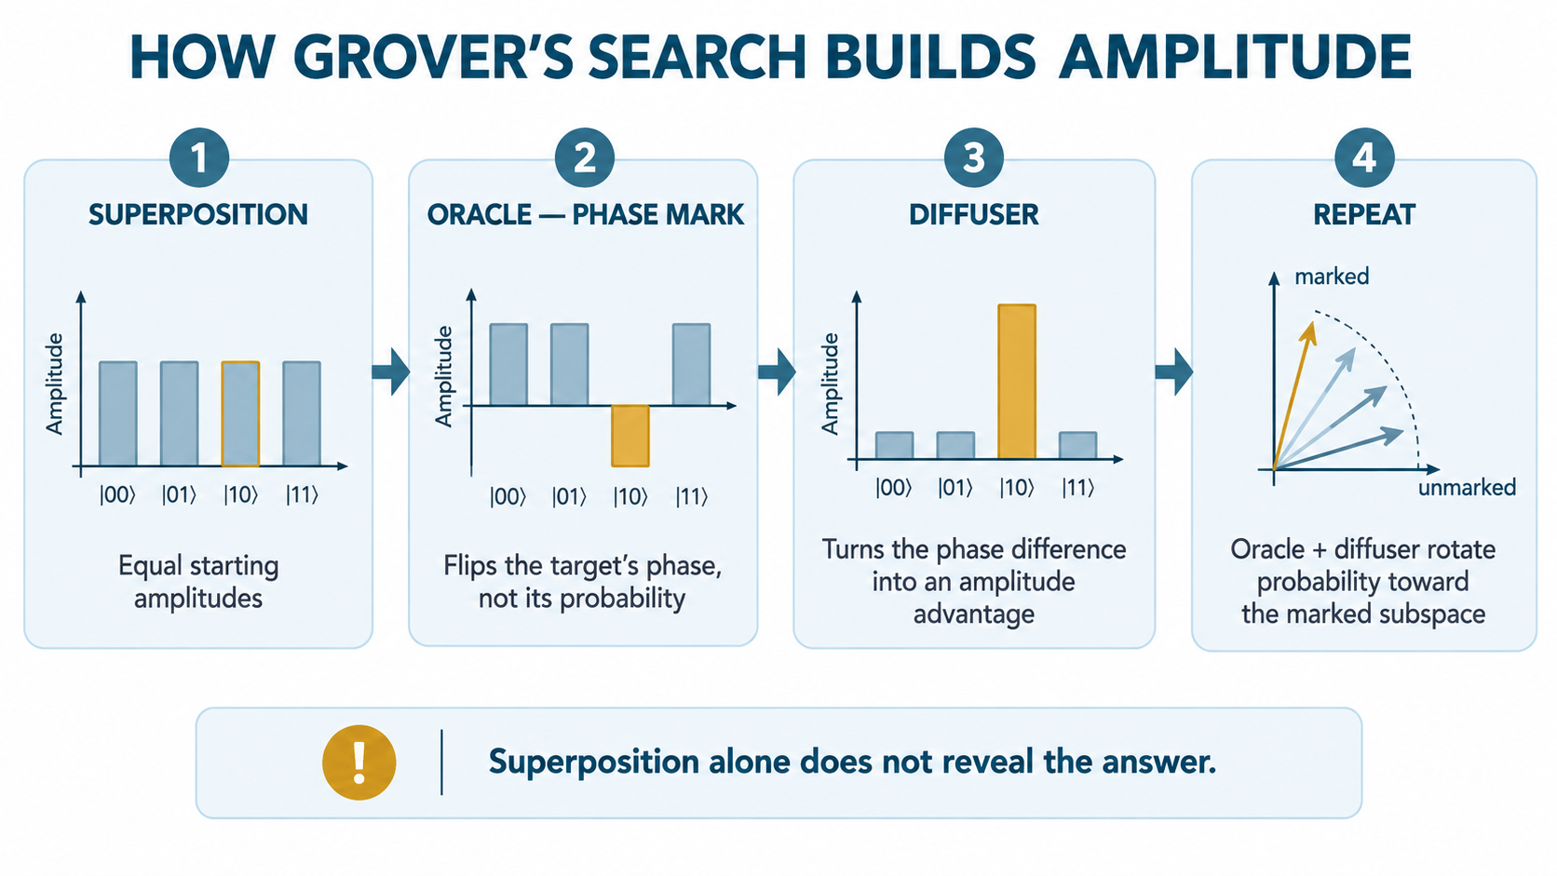

Slide 7
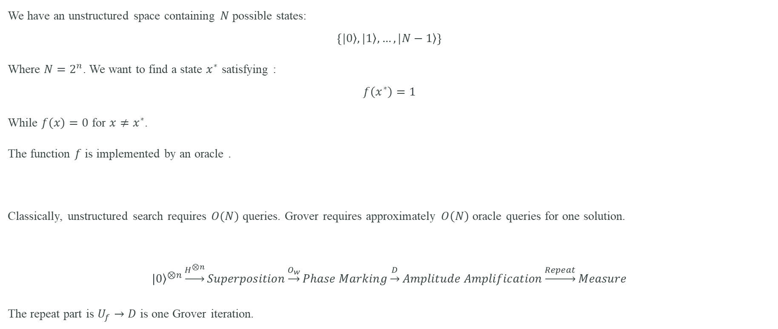
Grover’s algorithm: the problem
We have an unstructured space containing $N$ possible states:
$$\left\{\left.|0\right\rangle ,\left.|1\right\rangle ,…,\left.|N−1\right\rangle \right\}$$
Where $N=2^{n}$. We want to find a state $x^{∗}$ satisfying :
$$f\left(x^{∗}\right)=1$$
While $f\left(x\right)=0$ for $x≠x^{∗}$.
The function $f$ is implemented by an oracle .
Classically, unstructured search requires $O(N)$ queries. Grover requires approximately $O\left(N\right)$ oracle queries for one solution.
$${\left.|0\right\rangle }^{⊗n}\underset{→}{H^{⊗n}}Superposition\underset{→}{O_{w}}Phase Marking\underset{→}{D}Amplitude Amplification\underset{→}{Repeat}Measure$$
The repeat part is $U_{f}→D$ is one Grover iteration.

Slide 8
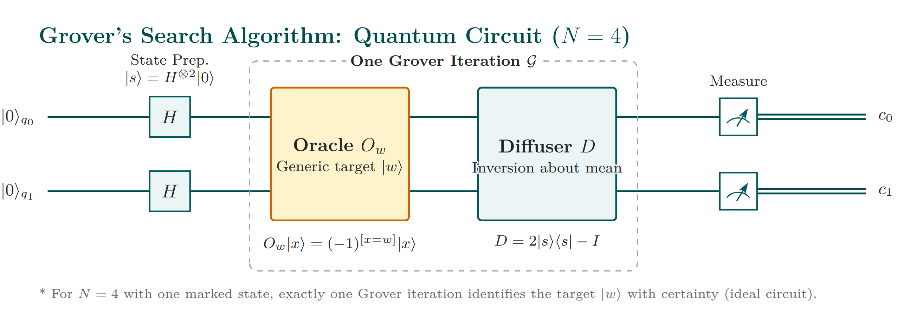

Slide 9
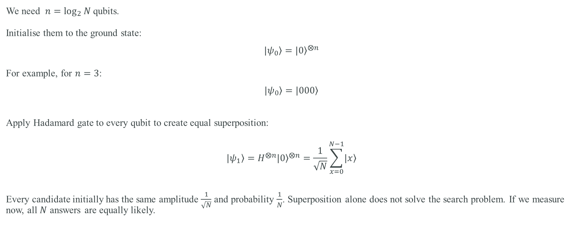
Step 1 — Initialisation And create an equal superposition
We need $n=\log_{2}{N}$qubits.
Initialise them to the ground state:
$$\left.|ψ_{0}\right\rangle ={\left.|0\right\rangle }^{⨂n}$$
For example, for $n=3$:
$$\left.|ψ_{0}\right\rangle =\left.|000\right\rangle$$
Apply Hadamard gate to every qubit to create equal superposition:
$$\left.|ψ_{1}\right\rangle =H^{⨂n}{\left.|0\right\rangle }^{⨂n}=\frac{1}{\sqrt{N}}\sum_{x=0}^{N−1}{\left.|x\right\rangle }$$
Every candidate initially has the same amplitude $\frac{1}{\sqrt{N}}$ and probability $\frac{1}{N}$. Superposition alone does not solve the search problem. If we measure now, all $N$ answers are equally likely.

Slide 10
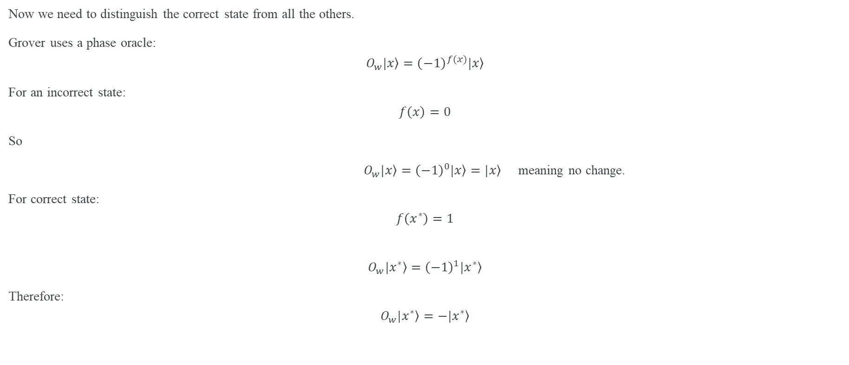
Step 2 — Apply the phase oracle $\left(O_{w}\right)$
Now we need to distinguish the correct state from all the others.
Grover uses a phase oracle:
$$O_{w}\left.|x\right\rangle ={\left(−1\right)}^{f(x)}\left.|x\right\rangle$$
For an incorrect state:
$$f\left(x\right)=0$$
So
$O_{w}\left.|x\right\rangle ={\left(−1\right)}^{0}\left.|x\right\rangle =\left.|x\right\rangle$ meaning no change.
For correct state:
$$f\left(x^{∗}\right)=1$$
$$O_{w}\left.|x^{∗}\right\rangle ={\left(−1\right)}^{1}\left.|x^{∗}\right\rangle$$
Therefore:
$$O_{w}\left.|x^{∗}\right\rangle =−\left.|x^{∗}\right\rangle$$

Slide 11
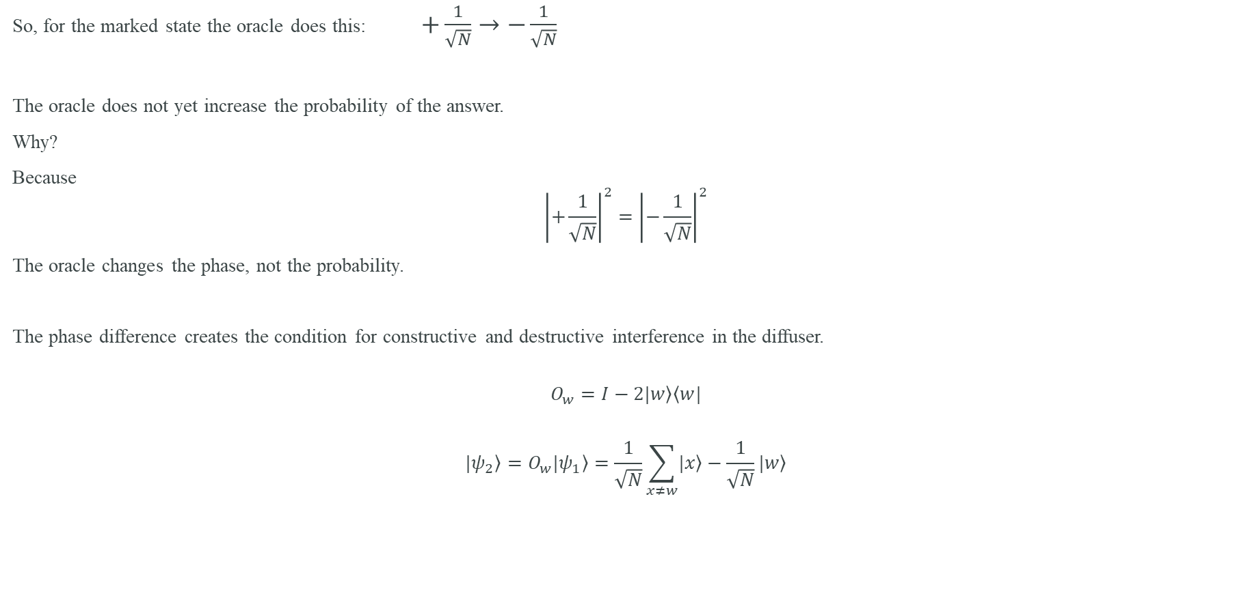
What does the phase oracle do?
So, for the marked state the oracle does this: $+\frac{1}{\sqrt{N}}→−\frac{1}{\sqrt{N}}$
The oracle does not yet increase the probability of the answer.
Why?
Because
$${\left|+\frac{1}{\sqrt{N}}\right|}^{2}={\left|−\frac{1}{\sqrt{N}}\right|}^{2}$$
The oracle changes the phase, not the probability.
The phase difference creates the condition for constructive and destructive interference in the diffuser.
$$O_{w}=I−2\left.|w\right\rangle \left\langle w|\right.$$
$$\left.|ψ_{2}\right\rangle =O_{w}\left.|ψ_{1}\right\rangle =\frac{1}{\sqrt{N}}\sum_{x≠w}{\left.|x\right\rangle −\frac{1}{\sqrt{N}}\left.|w\right\rangle }$$

Slide 12
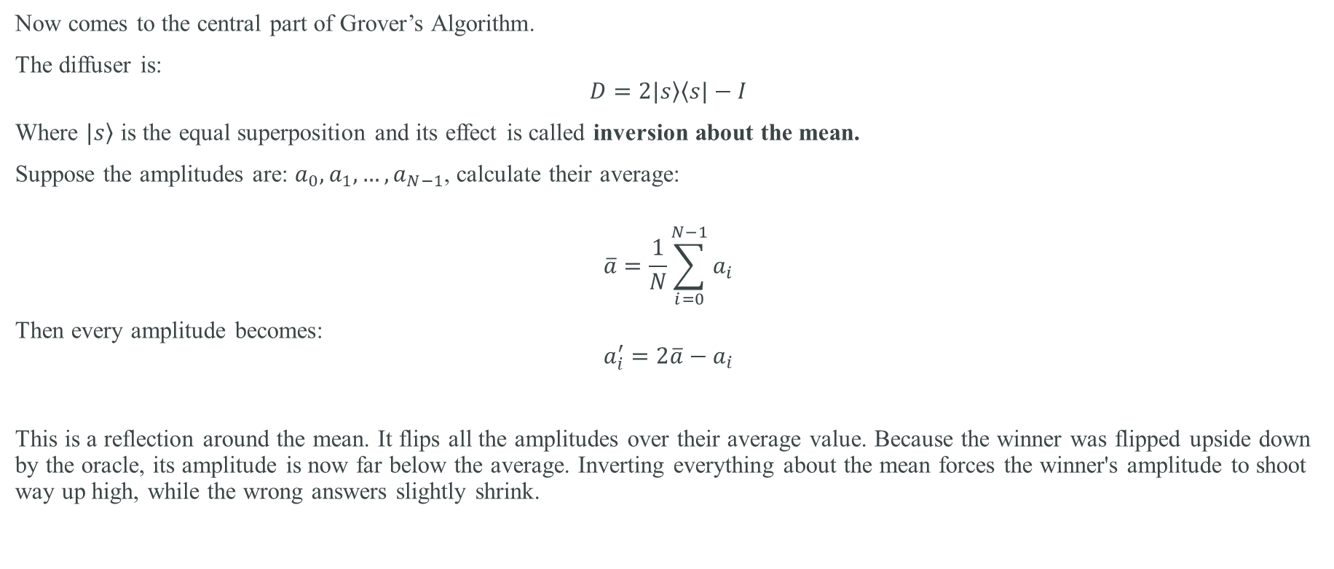
Step 3 — Apply the Diffuser
Now comes to the central part of Grover’s Algorithm.
The diffuser is:
$$D=2\left.|s\right\rangle \left\langle s|−I\right.$$
Where $\left.|s\right\rangle$ is the equal superposition and its effect is called inversion about the mean.
Suppose the amplitudes are: $a_{0},a_{1},…,a_{N−1}$, calculate their average:
$$\overline{a}=\frac{1}{N}\sum_{i=0}^{N−1}{a_{i}}$$
Then every amplitude becomes:
$$a_{i}^{′}=2\overline{a}−a_{i}$$
This is a reflection around the mean. It flips all the amplitudes over their average value. Because the winner was flipped upside down by the oracle, its amplitude is now far below the average. Inverting everything about the mean forces the winner's amplitude to shoot way up high, while the wrong answers slightly shrink.

Slide 13
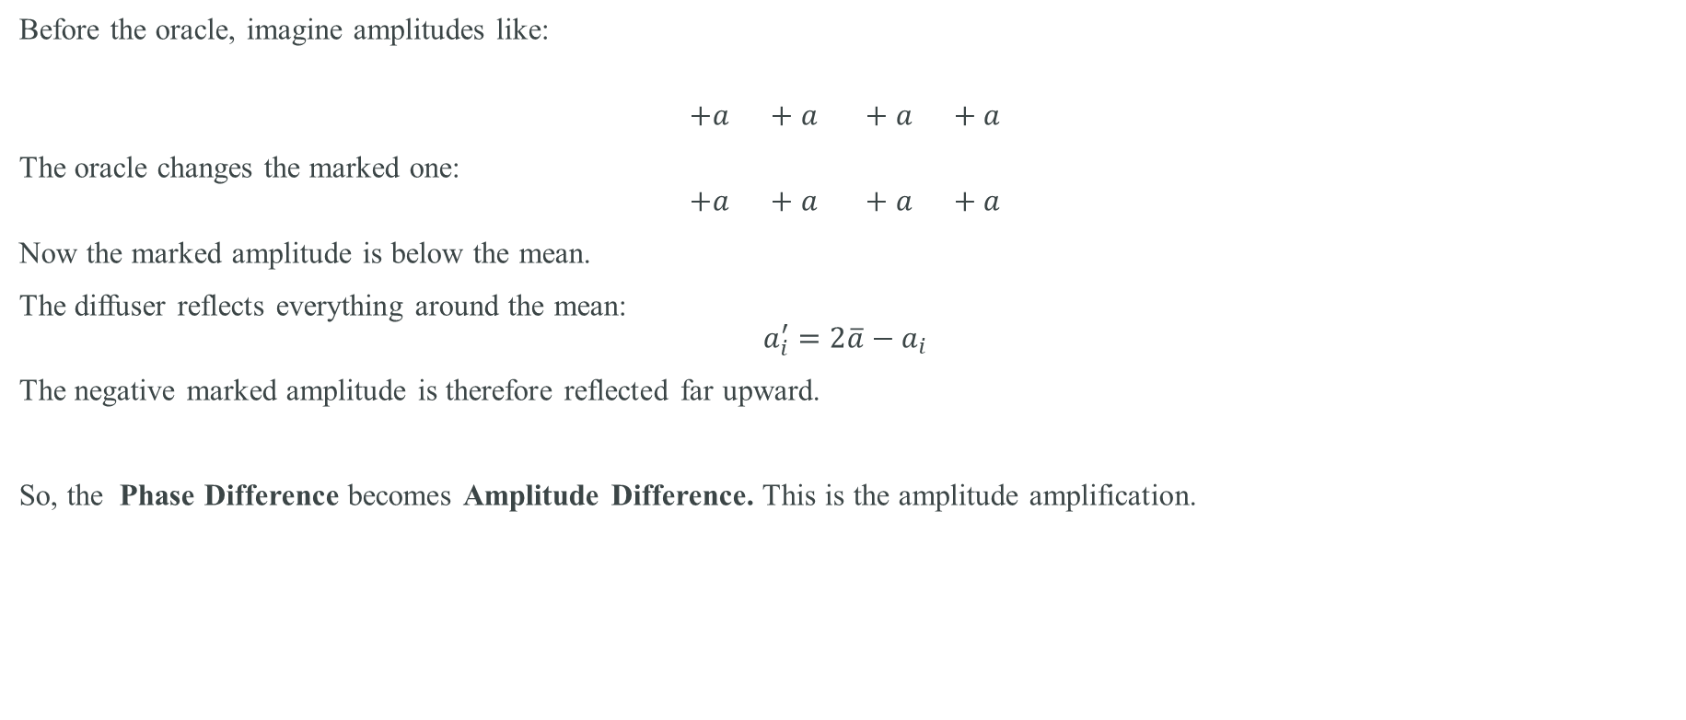
Why does the diffuser amplify the answer?
Before the oracle, imagine amplitudes like:
$$+a +a +a +a$$
The oracle changes the marked one:
$$+a +a +a +a$$
Now the marked amplitude is below the mean.
The diffuser reflects everything around the mean:
$$a_{i}^{′}=2\overline{a}−a_{i}$$
The negative marked amplitude is therefore reflected far upward.
So, the Phase Difference becomes Amplitude Difference. This is the amplitude amplification.

Slide 14
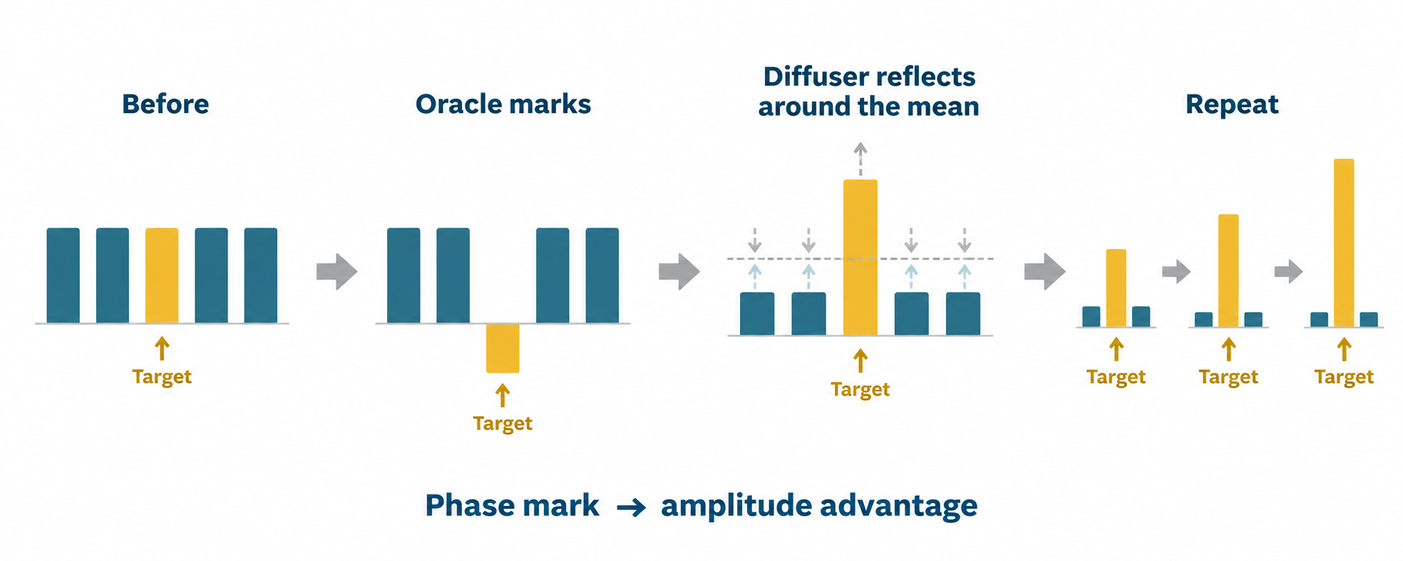

Slide 15
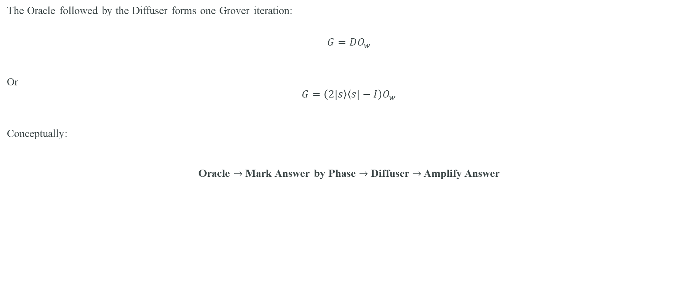
One Grover iteration
The Oracle followed by the Diffuser forms one Grover iteration:
$$G=DO_{w}$$
Or
$$G=\left(2\left.|s\right\rangle \left\langle s|−I\right.\right)O_{w}$$
Conceptually:
Oracle $→$ Mark Answer by Phase $→$ Diffuser $→$ Amplify Answer

Slide 16
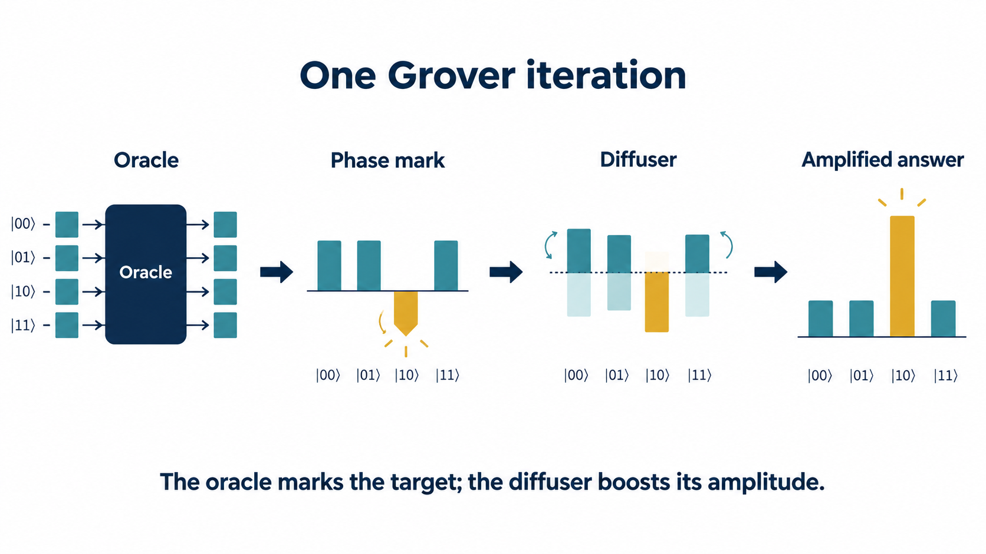

Slide 17
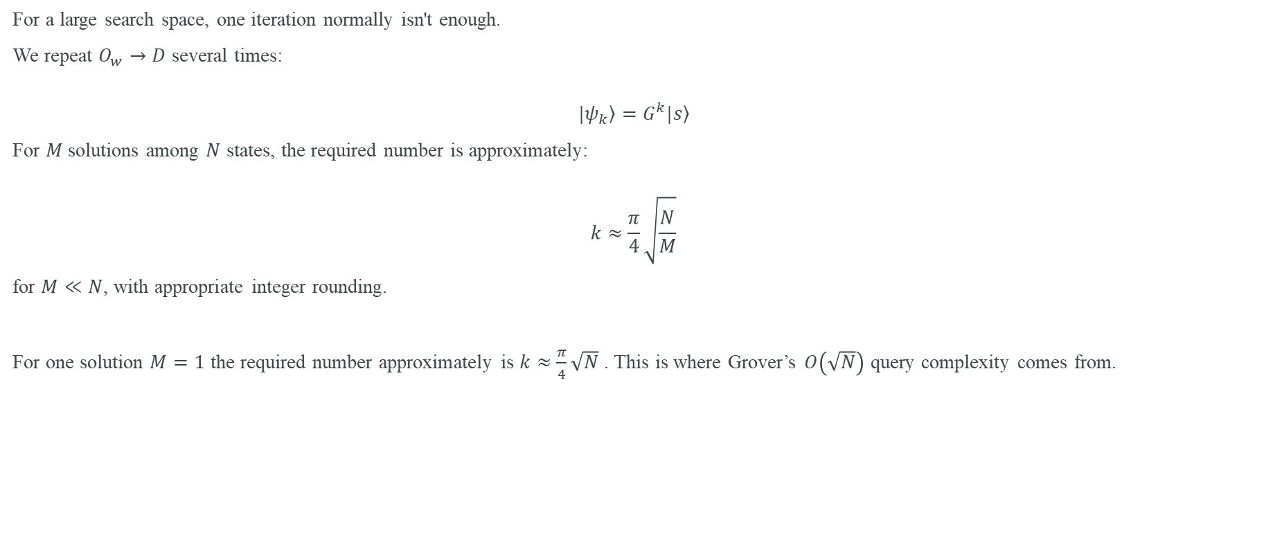
Step 4 — Repeat
For a large search space, one iteration normally isn't enough.
We repeat $O_{w}→D$ several times:
$$\left.|ψ_{k}\right\rangle =G^{k}\left.|s\right\rangle$$
For $M$ solutions among $N$ states, the required number is approximately:
$$k≈\frac{π}{4}\sqrt{\frac{N}{M}}$$
for $M≪N$, with appropriate integer rounding.
For one solution $M=1$ the required number approximately is $k≈\frac{π}{4}\sqrt{N}$ . This is where Grover’s $O\left(\sqrt{N}\right)$ query complexity comes from.

Slide 18
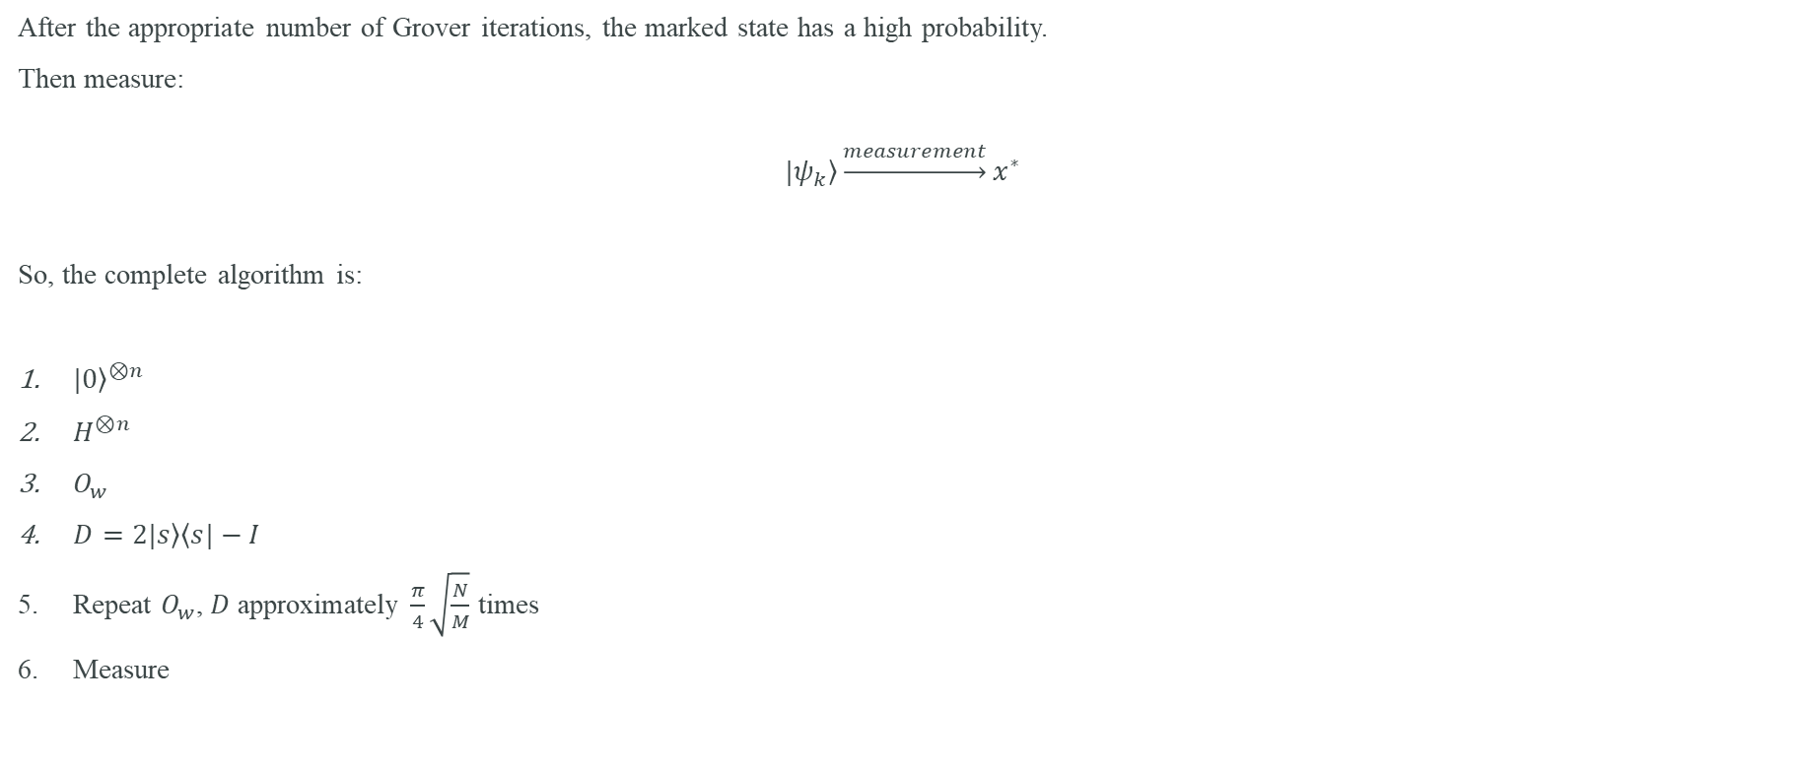
Step 5 — Measure
After the appropriate number of Grover iterations, the marked state has a high probability.
Then measure:
$$\left.|ψ_{k}\right\rangle \underset{→}{measurement}x^{∗}$$
So, the complete algorithm is:
${\left.|0\right\rangle }^{⊗n}$
$H^{⊗n}$
$O_{w}$
$D=2\left.|s\right\rangle \left\langle s|−I\right.$
Repeat $O_{w}$, $D$ approximately $\frac{π}{4}\sqrt{\frac{N}{M}}$ times
Measure

Slide 19
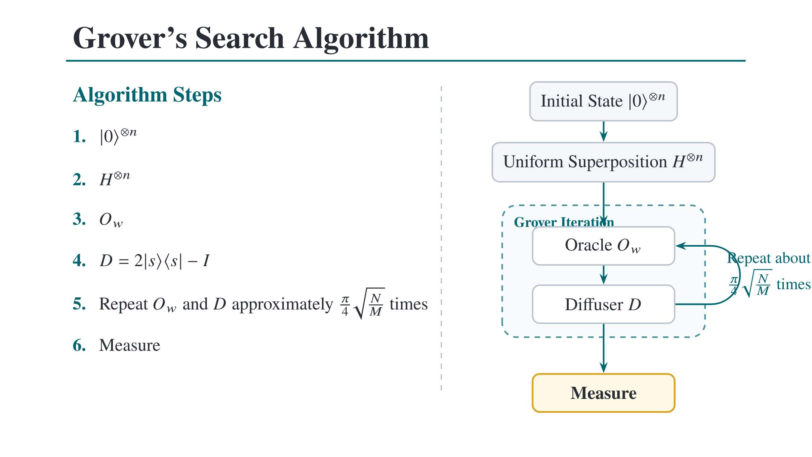

Slide 20
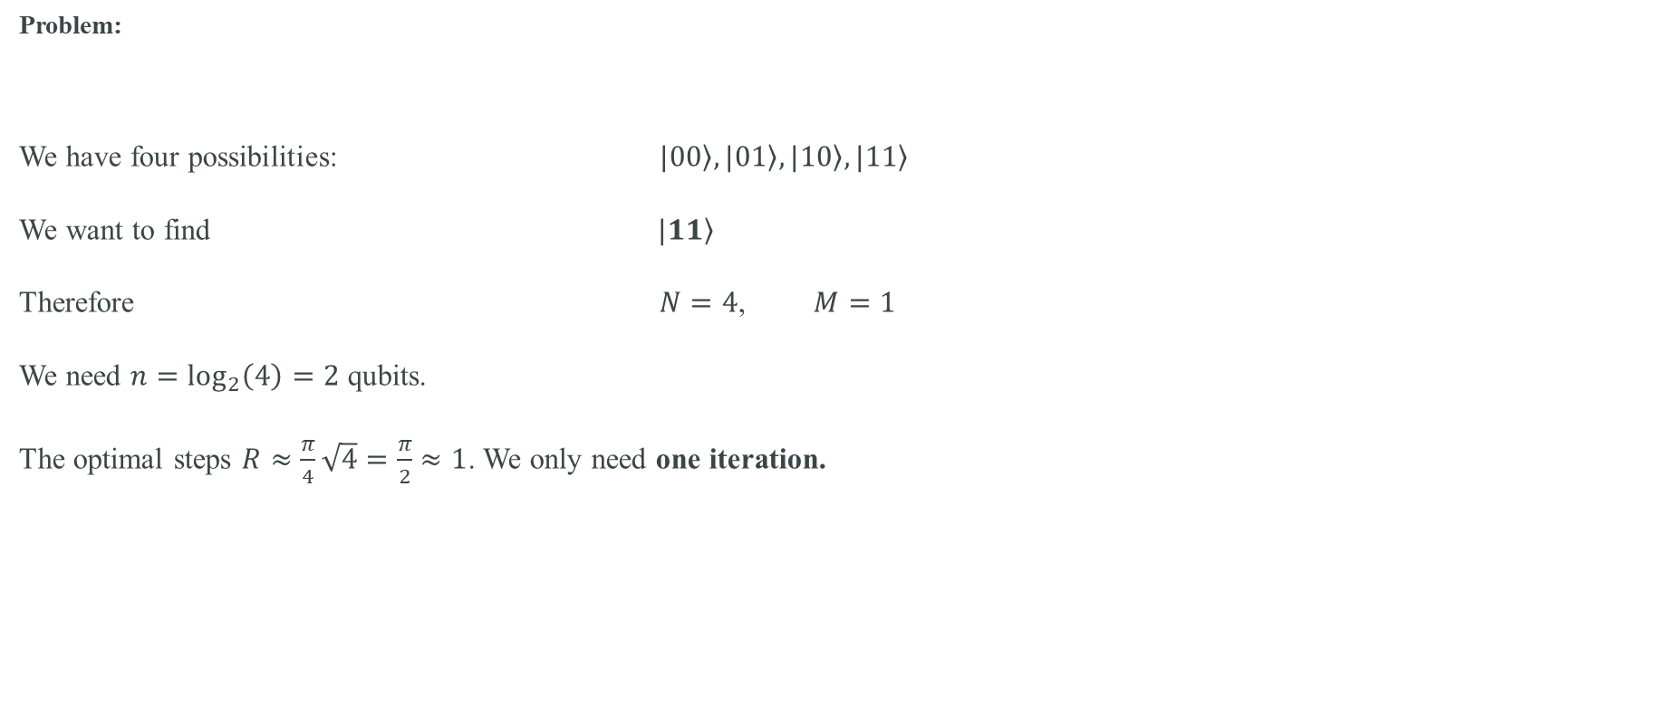
Grover’s algorithm Walkthrough Example
Problem:
We have four possibilities: $\left.|00\right\rangle ,\left.|01\right\rangle ,\left.|10\right\rangle ,\left.|11\right\rangle$
We want to find $\left.|11\right\rangle$
Therefore $N=4$, $M=1$
We need $n=\log_{2}\left(4\right)=2$ qubits.
The optimal steps $R≈\frac{π}{4}\sqrt{4}=\frac{π}{2}≈1$. We only need one iteration.

Slide 21
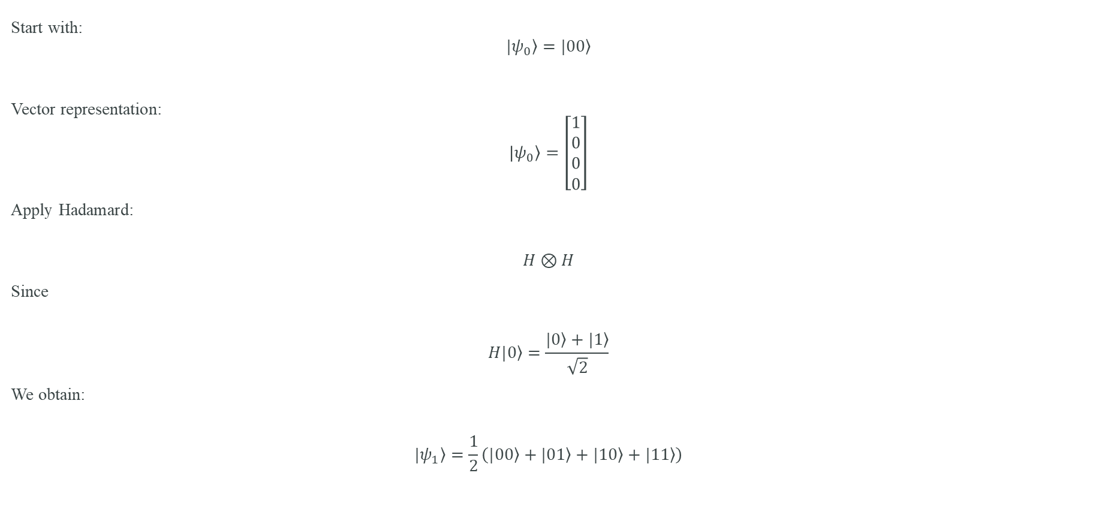
Example Step 1 — Initialize
Start with:
$$\left.|ψ_{0}\right\rangle =\left.|00\right\rangle$$
Vector representation:
$$\left.|ψ_{0}\right\rangle =\left[\begin{aligned}1 \\ 0 \\ 0 \\ 0\end{aligned}\right]$$
Apply Hadamard:
$$H⊗H$$
Since
$$H\left.|0\right\rangle =\frac{\left.|0\right\rangle +\left.|1\right\rangle }{\sqrt{2}}$$
We obtain:
$$\left.|ψ_{1}\right\rangle =\frac{1}{2}\left(\left.|00\right\rangle +\left.|01\right\rangle +\left.|10\right\rangle +\left.|11\right\rangle \right)$$

Slide 22
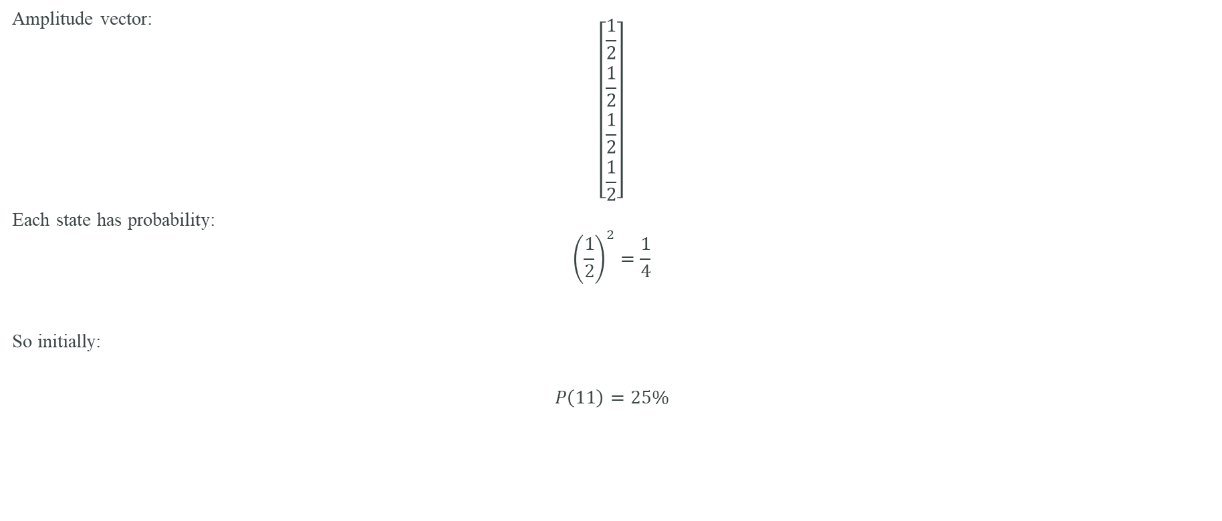
Example Step 1 — Hadamard and equal probability
Amplitude vector:
$$\left[\begin{aligned}\frac{1}{2} \\ \frac{1}{2} \\ \frac{1}{2} \\ \frac{1}{2}\end{aligned}\right]$$
Each state has probability:
$${\left(\frac{1}{2}\right)}^{2}=\frac{1}{4}$$
So initially:
$$P\left(11\right)=25\%$$

Slide 23
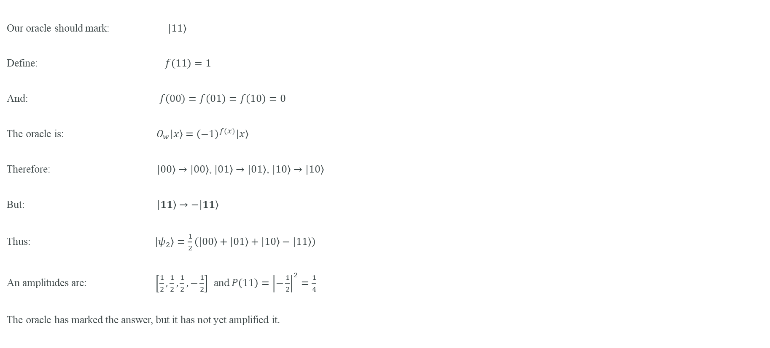
Example Step 2 — Apply the Oracle
Our oracle should mark: $\left.|11\right\rangle$
Define: $f\left(11\right)=1$
And: $f\left(00\right)=f\left(01\right)=f\left(10\right)=0$
The oracle is: $O_{w}\left.|x\right\rangle ={\left(−1\right)}^{f(x)}\left.|x\right\rangle$
Therefore: $\left.|00\right\rangle →\left.|00\right\rangle$, $\left.|01\right\rangle →\left.|01\right\rangle$, $\left.|10\right\rangle →\left.|10\right\rangle$
But: $\left.|11\right\rangle →\left.−|11\right\rangle$
Thus: $\left.|ψ_{2}\right\rangle =\frac{1}{2}\left(\left.|00\right\rangle +\left.|01\right\rangle +\left.|10\right\rangle −\left.|11\right\rangle \right)$
An amplitudes are: $\left[\frac{1}{2}, \frac{1}{2},\frac{1}{2},−\frac{1}{2}\right]$ and $P\left(11\right)={\left|−\frac{1}{2}\right|}^{2}=\frac{1}{4}$
The oracle has marked the answer, but it has not yet amplified it.

Slide 24
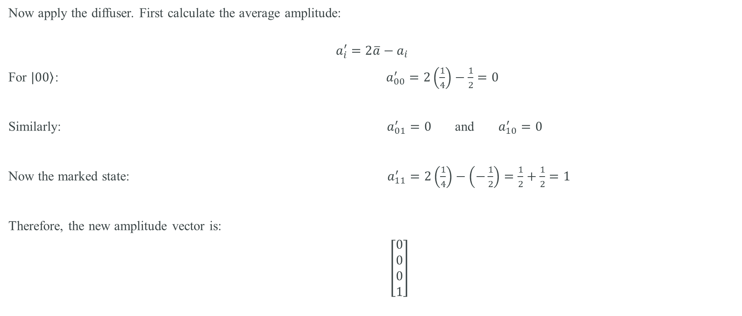
Example Step 3 — Calculate the mean
Now apply the diffuser. First calculate the average amplitude:
$$a_{i}^{′}=2\overline{a}−a_{i}$$
For $\left.|00\right\rangle$: $a_{00}^{′}=2\left(\frac{1}{4}\right)−\frac{1}{2}=0$
Similarly: $a_{01}^{′}=0$ and $a_{10}^{′}=0$
Now the marked state: $a_{11}^{′}=2\left(\frac{1}{4}\right)−\left(−\frac{1}{2}\right)=\frac{1}{2}+\frac{1}{2}=1$
Therefore, the new amplitude vector is:
$\left[\begin{aligned}0 \\ 0 \\ 0 \\ 1\end{aligned}\right]$

Slide 25
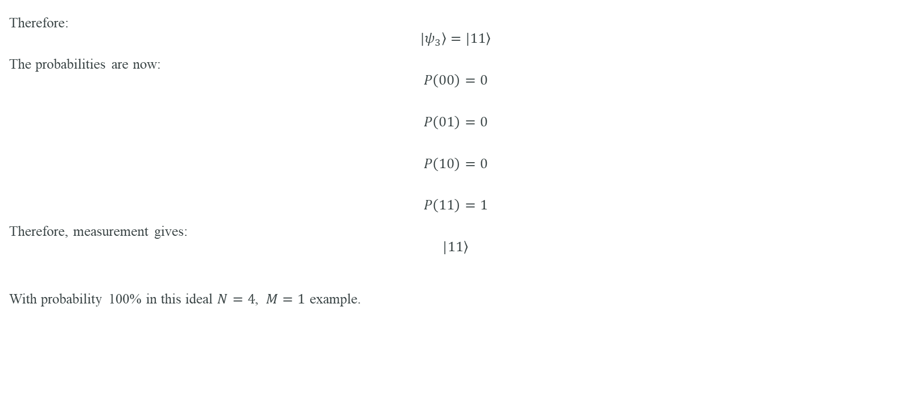
Example Step 5 — Final state
Therefore:
$$\left.|ψ_{3}\right\rangle =\left.|11\right\rangle$$
The probabilities are now:
$$P\left(00\right)=0$$
$$P\left(01\right)=0$$
$$P\left(10\right)=0$$
$$P\left(11\right)=1$$
Therefore, measurement gives:
$$\left.|11\right\rangle$$
With probability 100% in this ideal $N=4$, $M=1$ example.

Slide 26
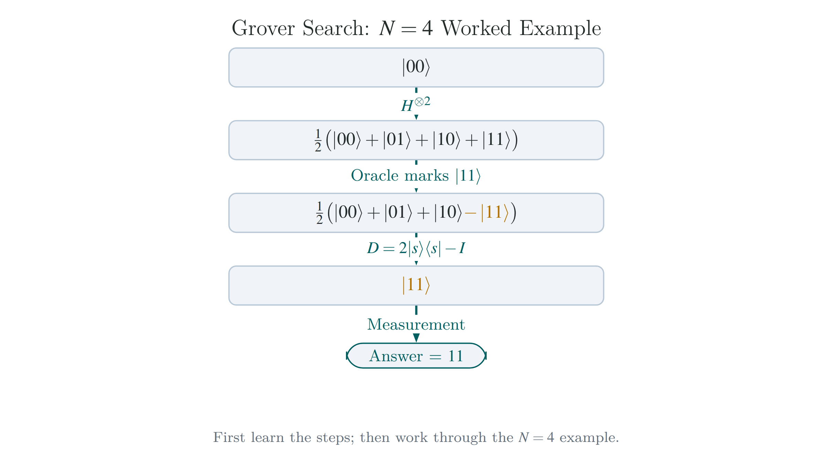
the compact sequence

Slide 27


